Slide 1
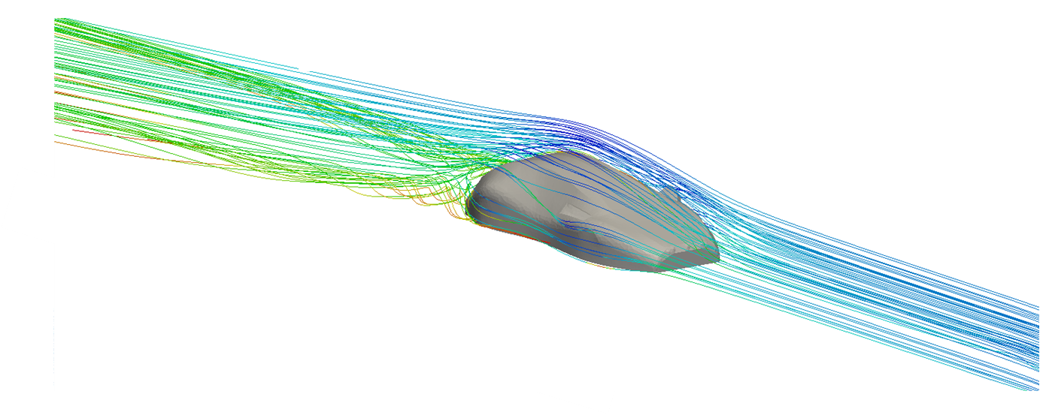
Virtual Wind Tunnel
Luke Blades, Heather Bolt, Felix Browne, Edward Crinion, David Docherty, Luke Hamilton, Dan Nima, James Walton

Slide 2
Introduction
Aim
Investigate the integration of Computer Aided Design (CAD), Computational Fluid Dynamics (CFD) and experimentation in automotive design
Deliverables
Design and manufacture concept car model
Create virtual wind tunnel in which to test the CAD model
Rebuild wind tunnel test section and use to validate simulations
Sub-Group Structure
Design
Experimental
High Performance Computing (HPC)

Slide 3
Design Sub-Group
Concept car design
Production of scale models using Additive Layer Manufacture (ALM)
Investigation of suitable meshing strategies
Virtual rendering of final concept car design

Slide 4
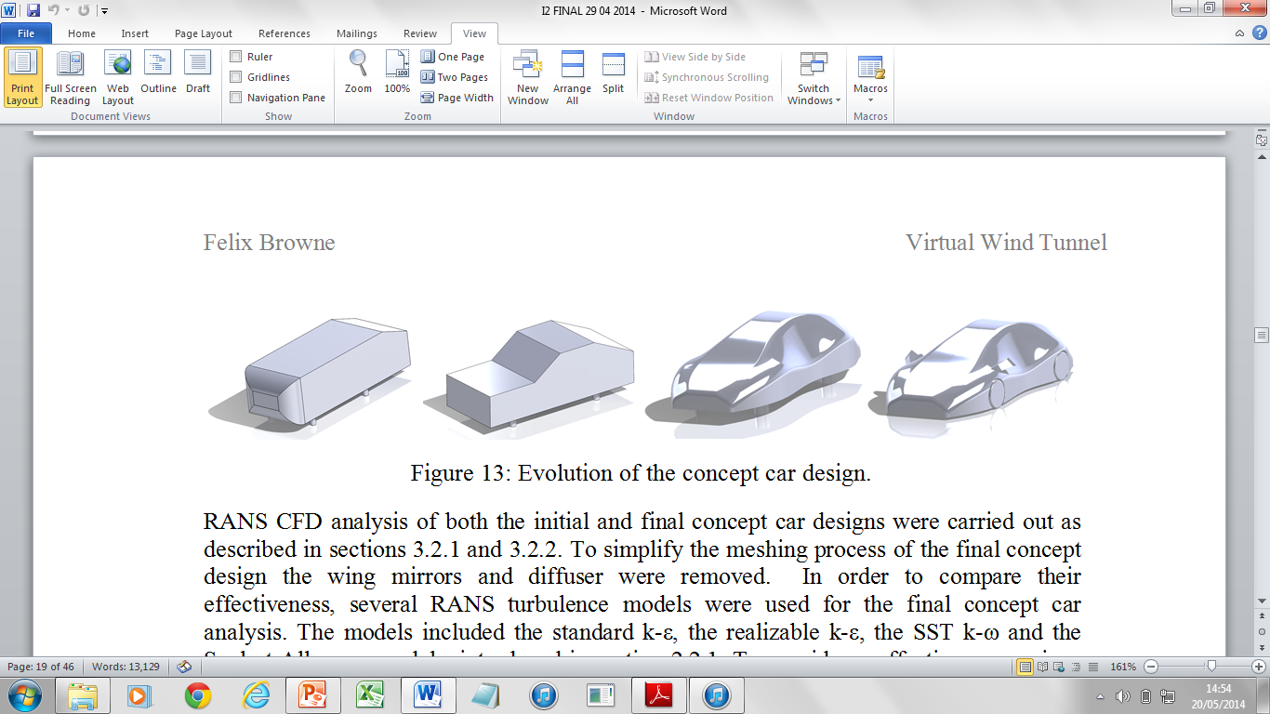
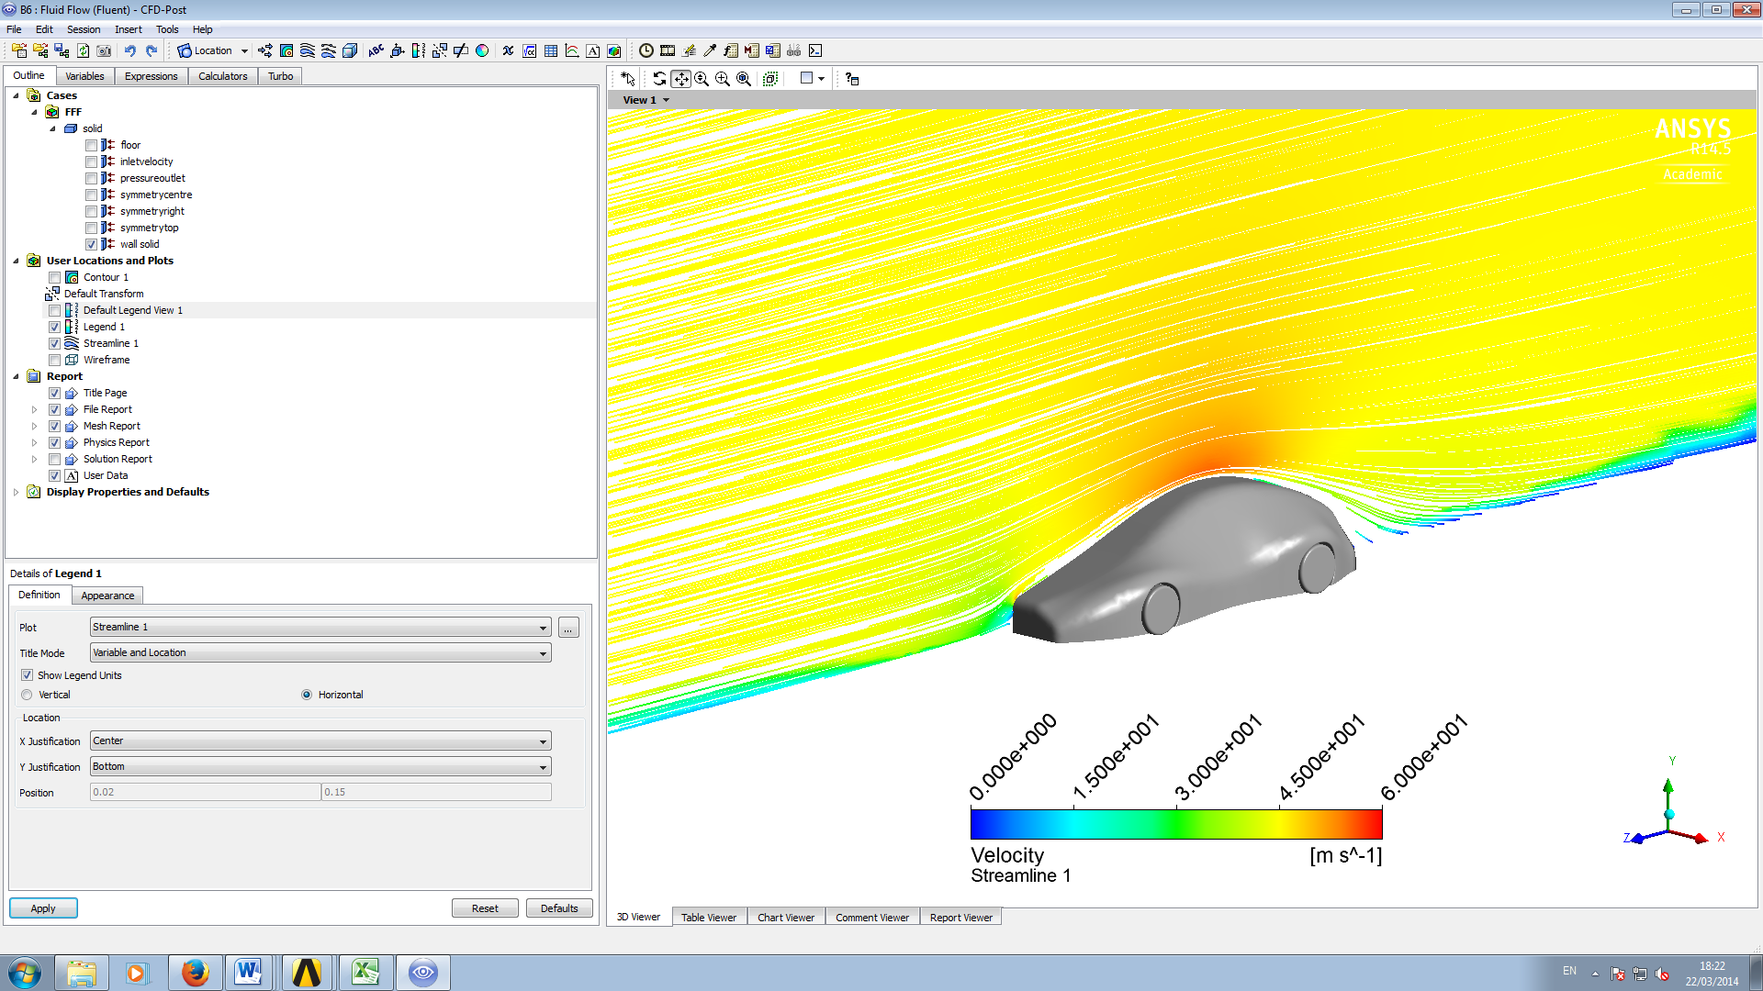
Design: Concept Car
Concept car design evolution
RANS CFD analysis

Slide 5
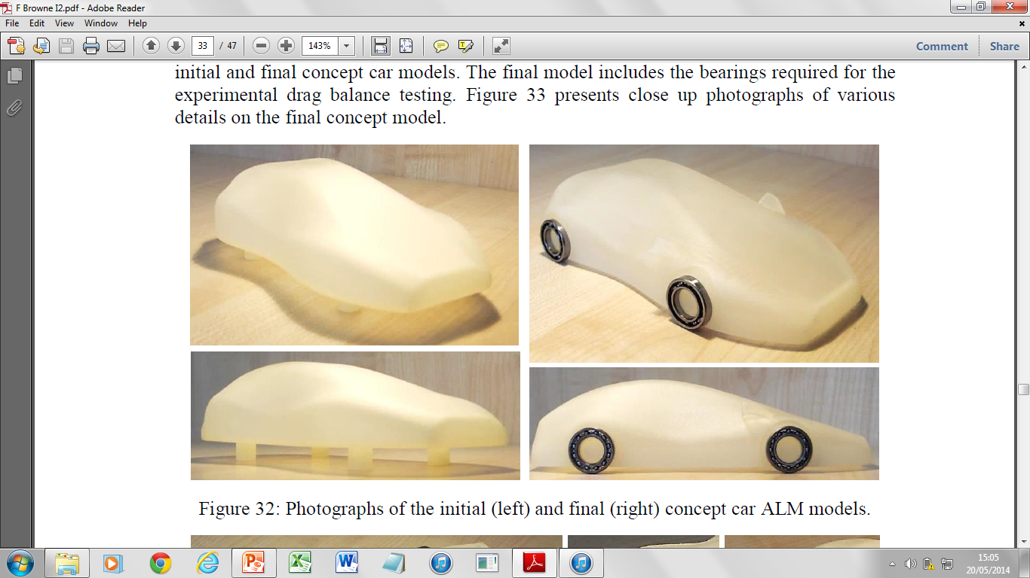
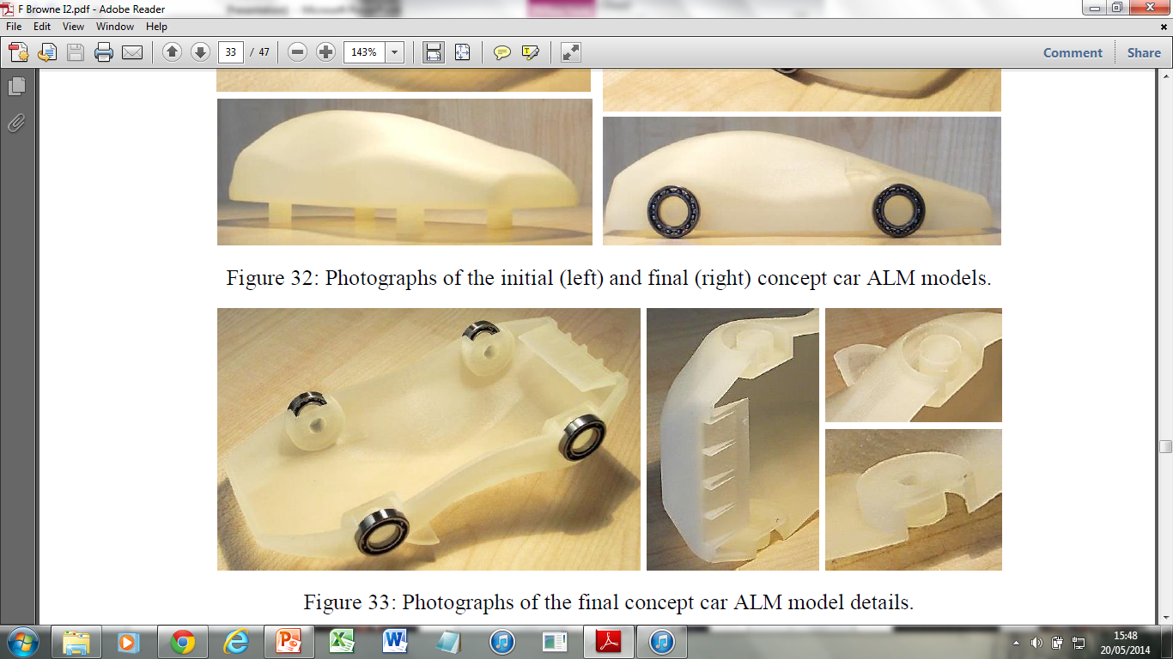
Design: ALM of Scale Models
Material jetting process used to produce scale models

Slide 6
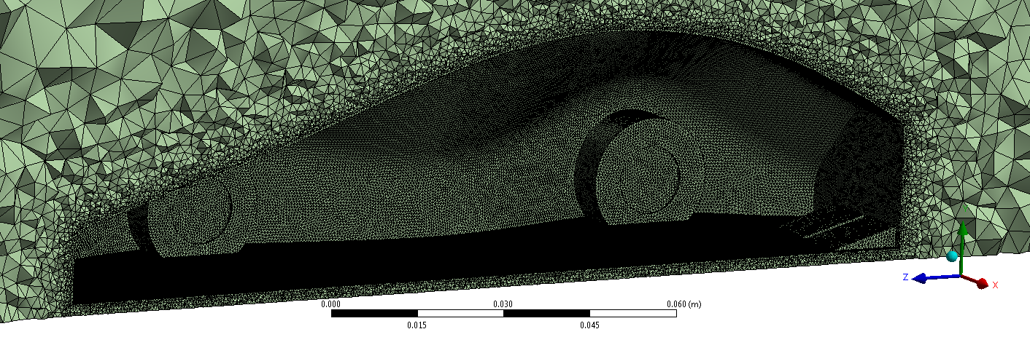
Design: Mesh Generation Overview
Critical step in CFD process
Affected by many factors
Mesh quality can be measured in various ways
Multiple methods for improving quality, post-assessment

Slide 7
Design: Mesh Experimentation Results
Solution accuracy comparison for various meshing schemes
Mesh quality information collected
Tet PI found to be most robust and accurate: variance of 3.73% from experimental
Tet PI then used on final concept car later on

Slide 8
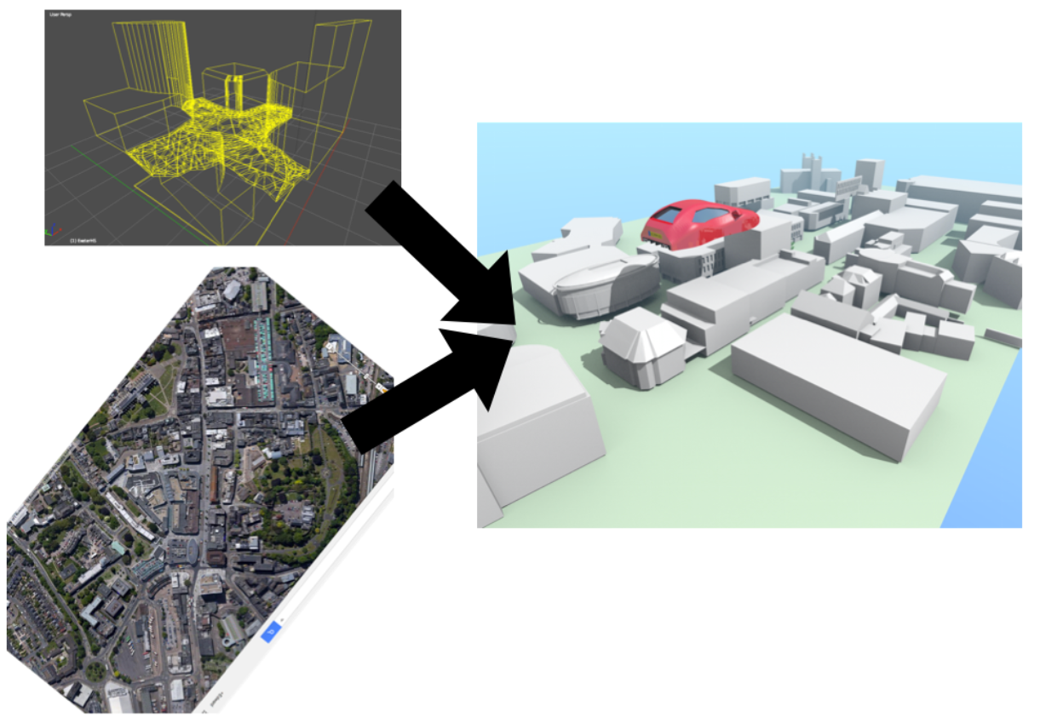
Design: Rendering
Aim: render the concept car in Exeter
Used path-tracing light solving method in Blender
Data from Electronic Distance Measuring (EDM) and Google Earth
Photons from each pixel are traced back

Slide 9
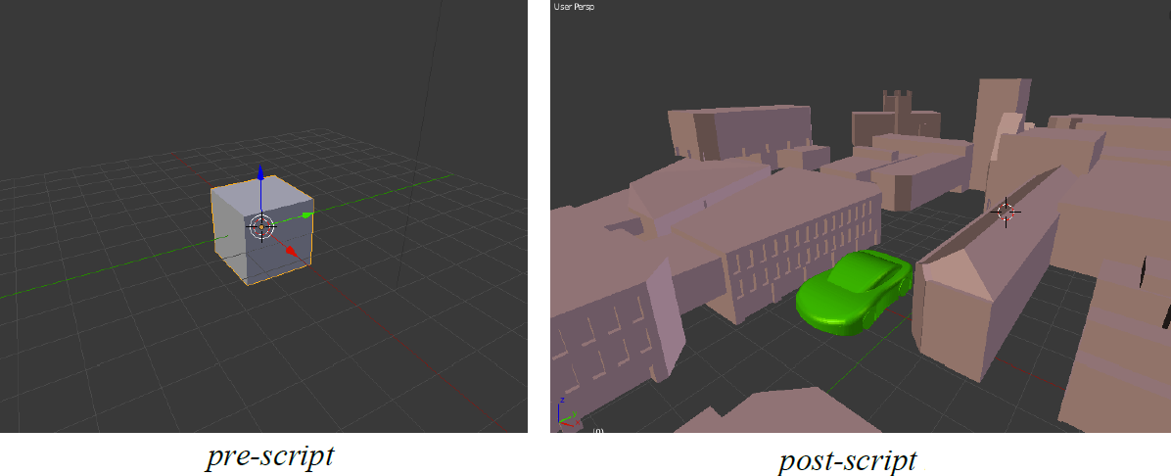
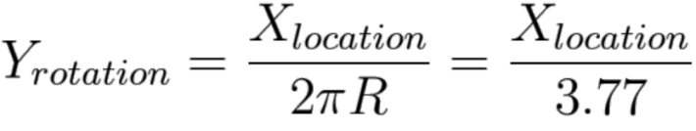
Design: Rendering
Blender is partially written in Python, so a script can automate the process
‘Drivers’ link different objects’ parameters
Wheel rotation is dependent on car displacement, for example

Slide 10
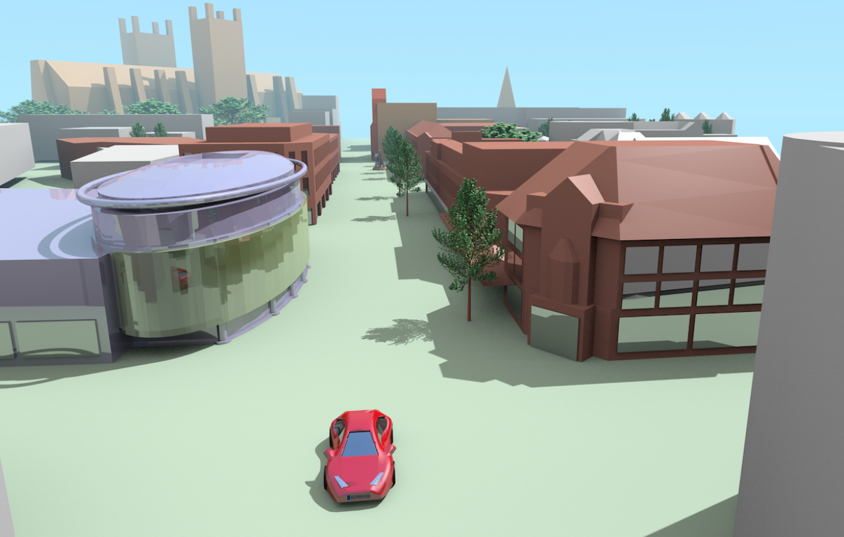
Design: Rendering
At this complexity, rendering takes 15 minutes per frame

Slide 11
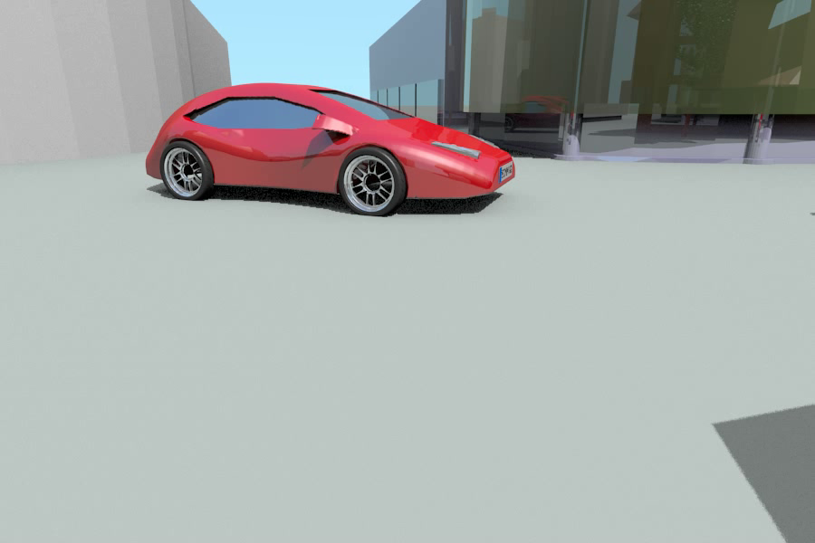
Design: Rendering

Slide 12
Design Group Summary
Iteratively designed concept car
Delivered physical model for testing
Delivered CAD model for virtual testing
PI Tet found to be the most robust and accurate meshing process
Rendered model in virtual environment

Slide 13
Experimental Sub-Group
Responsible for gathering real wind tunnel data for the concept car, comparable to CFD results
Drag forces were obtained through the use of drag balances and a wake survey
A wind tunnel was modified to provide this data

Slide 14
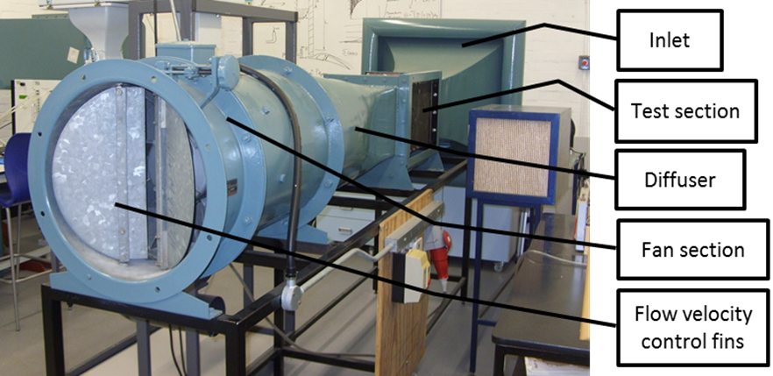
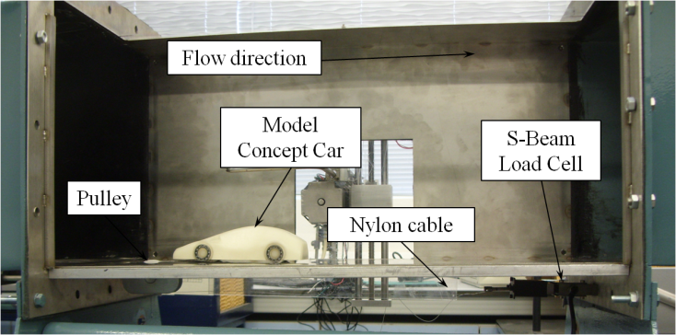
Experimental: Test Section Rebuild
The test section of an open return wind tunnel was redesigned and rebuilt
This improved model visibility for smoke visualisation through fully transparent top and front
It also supported the use of automated wake survey equipment

Slide 15
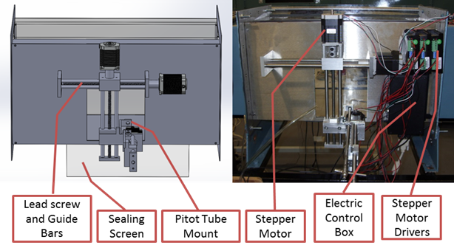
Experimental: Automated Probe Positioning
To perform the wake survey a probe (either pitot-static tube or hot wire anemometer) had to be positioned automatically
This system was powered with stepper motors and controlled with a Raspberry Pi computer, on which a python script was written

Slide 16
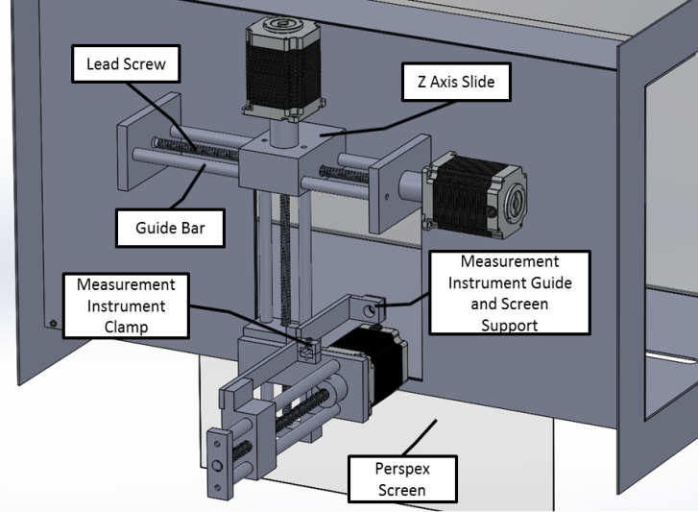
Experimental: Wake Survey
Two – dimensional wake surveys were obtained using the probe positioning system
This provided a square grid of velocity measurements taken 5mm apart
From these, Von Karman's principle of momentum conservation was used to calculate the total drag on the car by summing the momentum losses

Slide 17
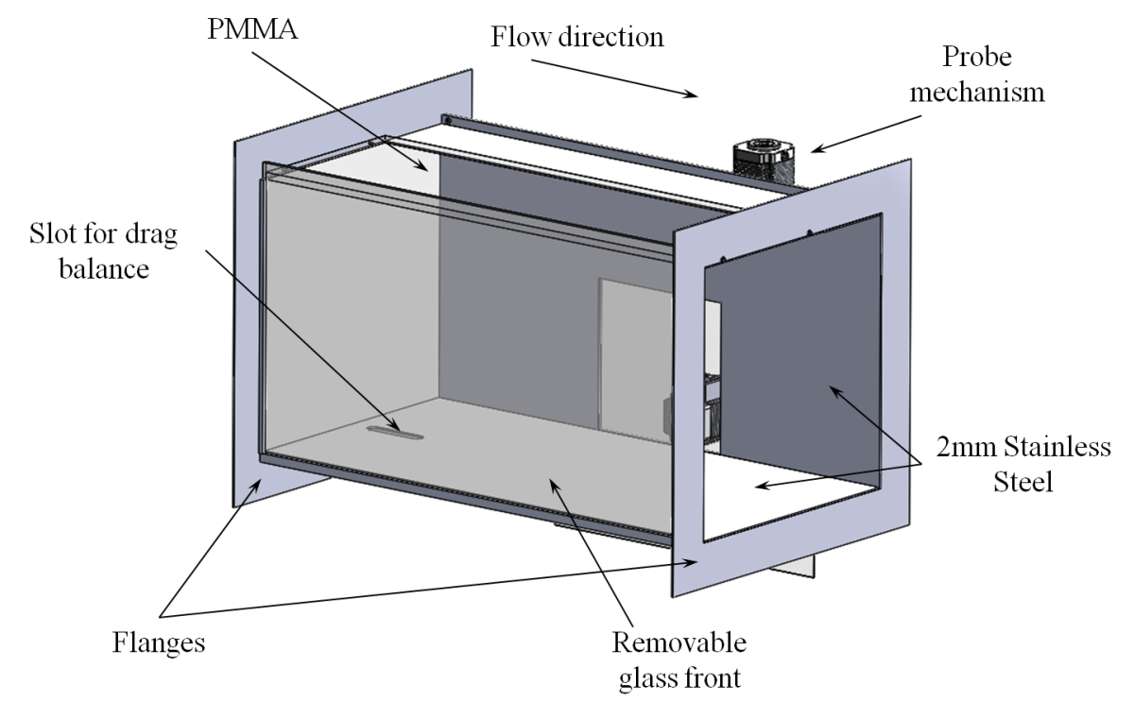
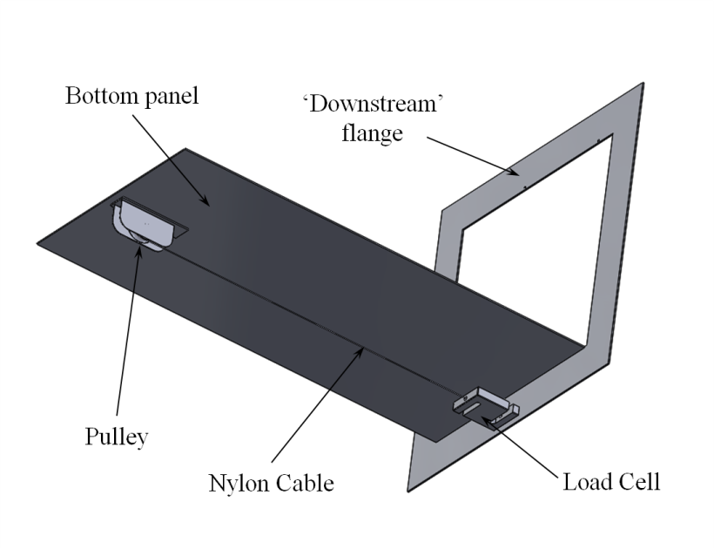
Experimental: Drag Balance
The second experimental method involved using a drag balance

Slide 18
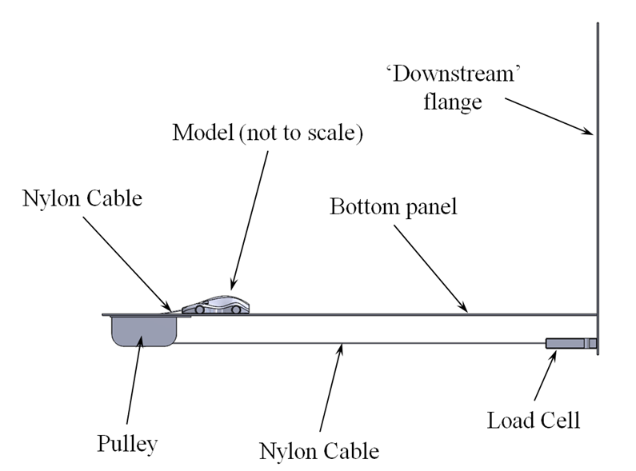
Experimental: Drag Balance
S-Beam Load Cell: ±0.005N
Digital Force Meter: ±0.049N

Slide 19
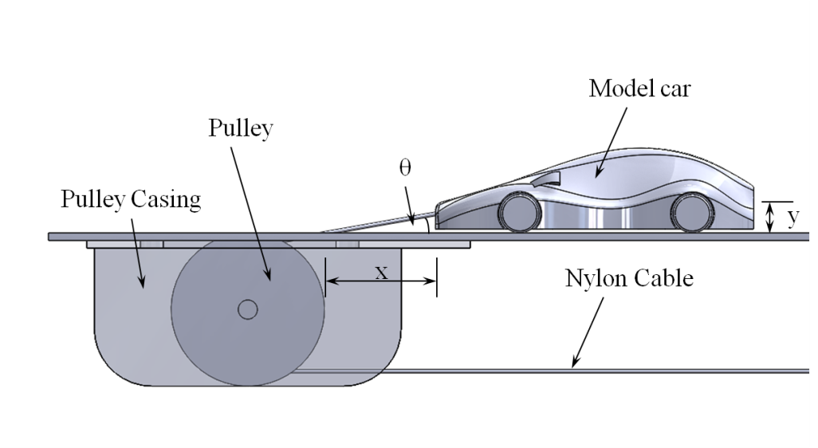
Experimental: Angle of Cable
In this case:
x = 290mm
y = 1.99mm
Therefore, from trigonometry, θ = 0.39⁰

Slide 20
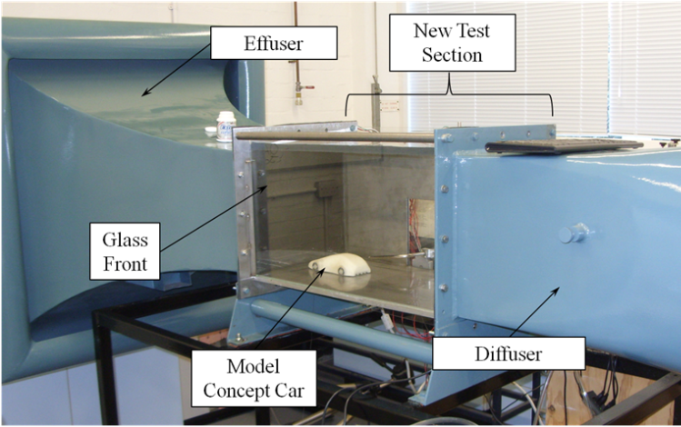
Summary of Experimentation
Redesigned and built a new wind tunnel test section
Concept Car Drag Coefficients:
Wake Survey (Angled): 0.358 ± 0.077
Drag Balance (Straight): 0.17± 0.015

Slide 21
HPC Sub-Group
OpenFOAM used due to it being open-source, this allowed for parallel processing on many cores
Responsible for gathering computational results for the concept car, to be verified by the experimental team
Considered a variety of turbulence models and meshing methods to create the final virtual wind tunnel case setup
Explored the influence of urban canyon flow on the aerodynamic properties of a vehicle
Investigated a surrogate-based modelling approach

Slide 22
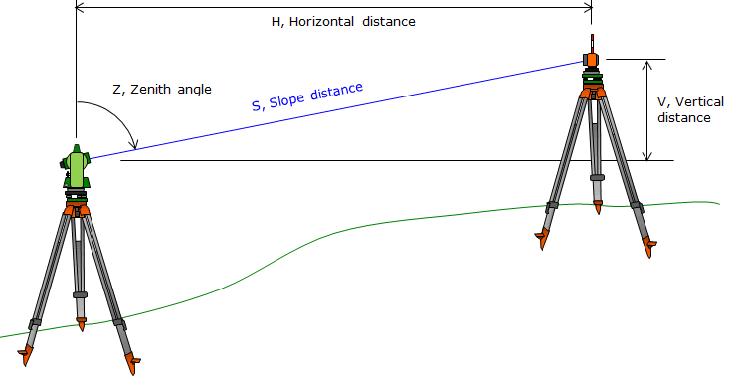
HPC: Environment Creation
Using an Electronic Distance Measuring (EDM) Total Station, the area was mapped out
Co-ordinate data manipulated by AutoCAD Civil 3D and Solidworks

Slide 23
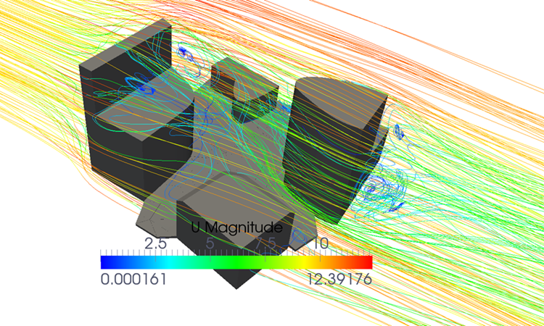
HPC: Urban Canyon Flow
OpenFOAM used as the CFD program
Probes were placed in areas of interest to measure the important data

Slide 24
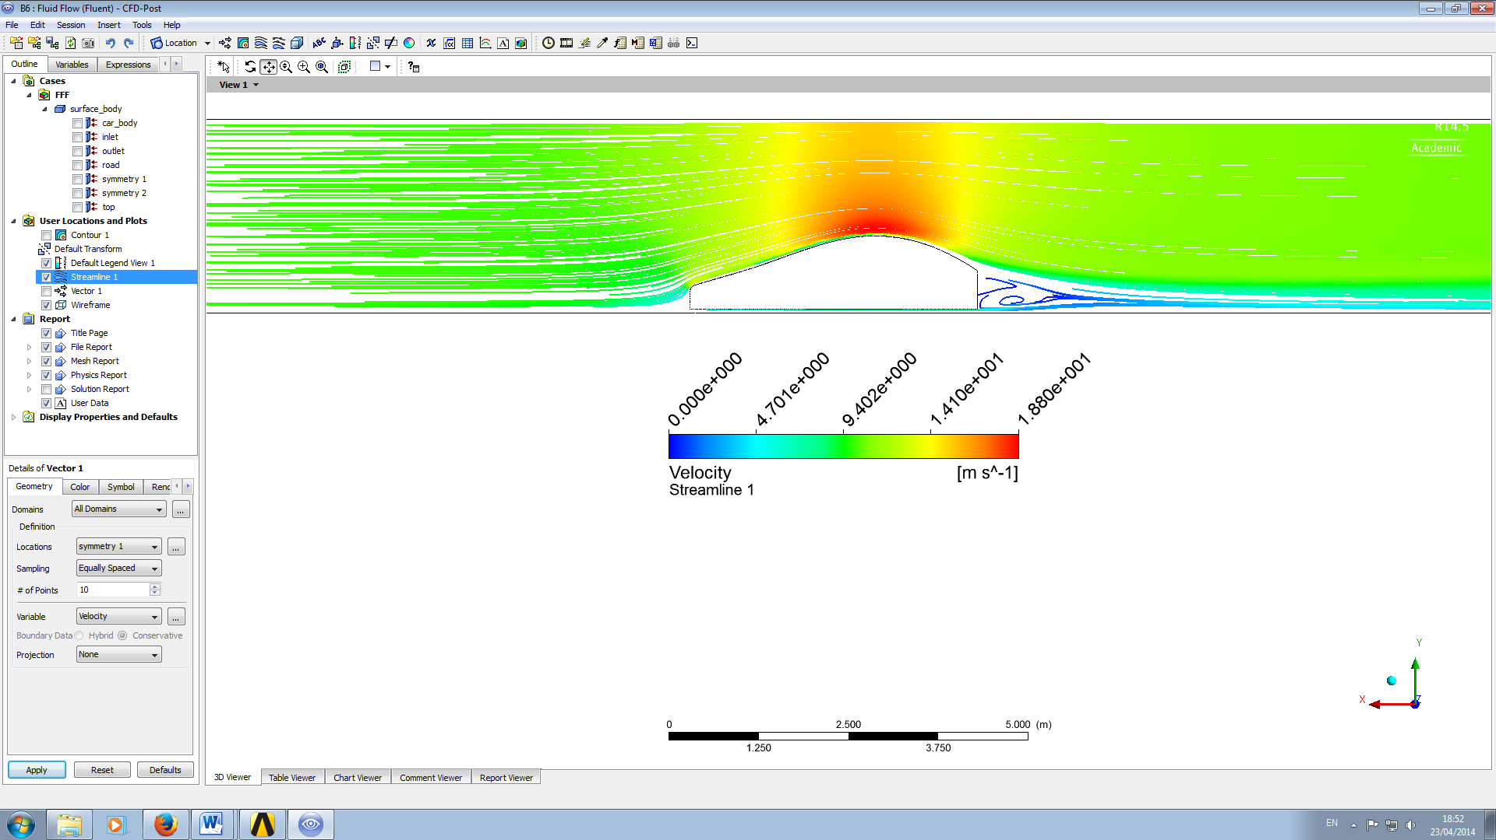
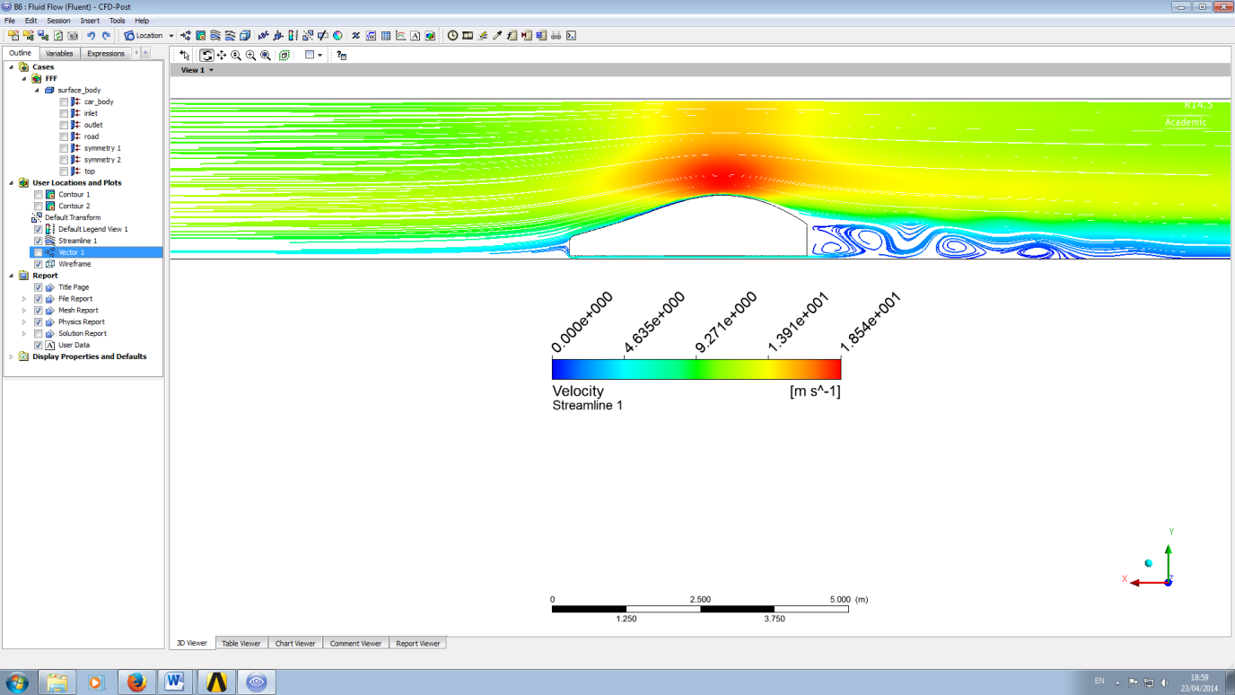
HPC: Concept Car Comparison
The velocity plot could be used as an inlet for the concept car
It was then compared to a typical uniform inlet, giving a 30% increase in the drag force
Uniform 10m/s inlet
UDF
inlet

Slide 25
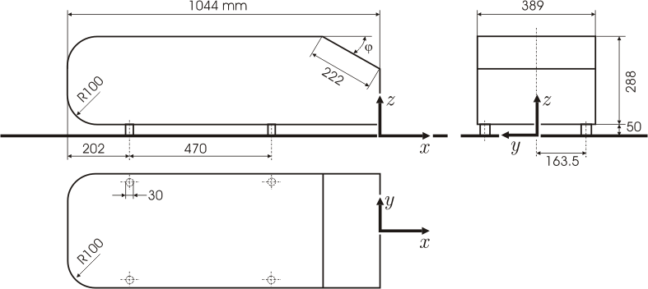
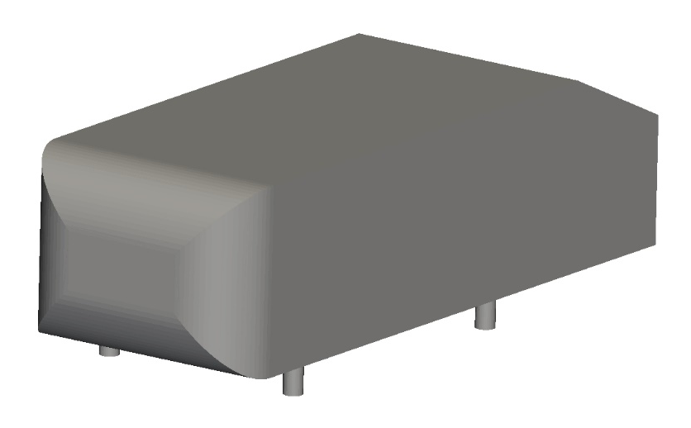
HPC: The Ahmed Body
Simplified model of the geometry of a generic car
Used as a benchmark case for investigating automobile flow
CFD Online, 2005. File:Ahmed.gif. [online] Available at: http://www.cfd-online.com/Wiki/File:Ahmed.gif [Accessed 21/05/2014]

Slide 26
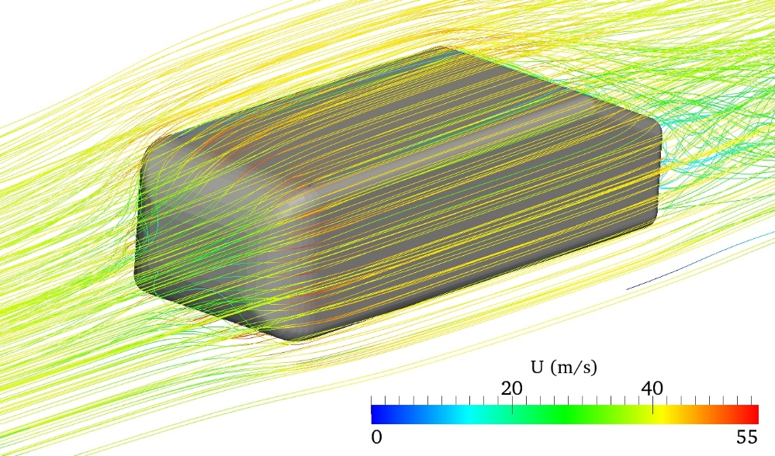
HPC: Surrogate Modelling
Surrogate models are fast approximations of computationally expensive simulations based upon a limited set of data
Input Parameters
Rear slant angle (5° - 45°)
Fillet radius (0mm – 50mm)
Output Result
Drag coefficient
Data set creation for surrogate model was automated & 35 simulations were run

Slide 27
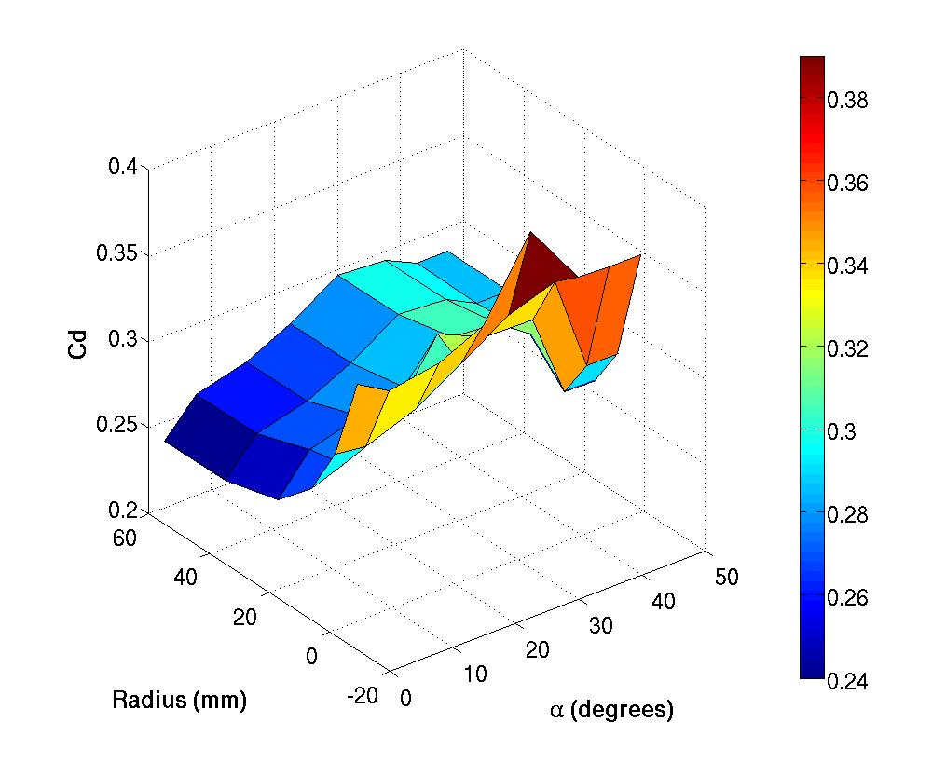
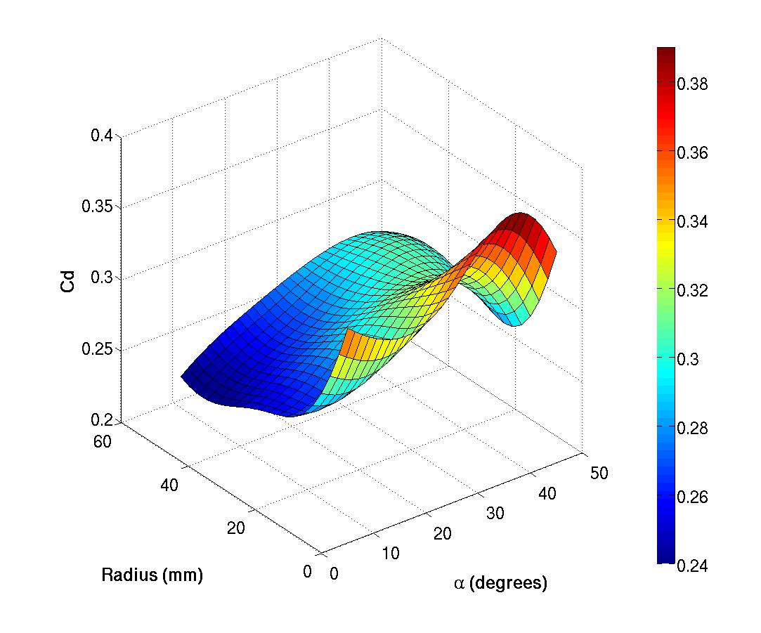
HPC: Surrogate Model Results
CFD Results Surrogate Model Results

Slide 28
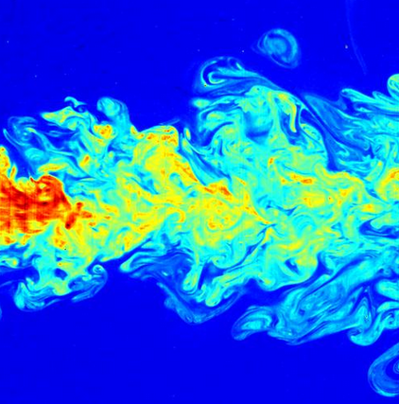
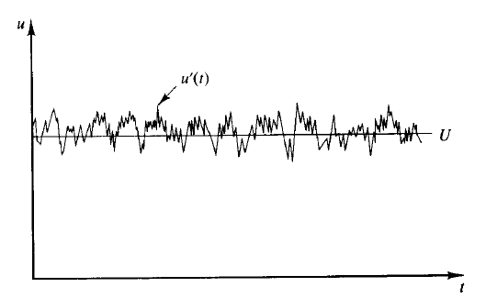
HPC: Turbulence
Turbulent flow causes flow properties to fluctuate irregularly about a mean value
Turbulence models are used to approximate small fluctuations seen in turbulent flow to reduce computational expense
http://upload.wikimedia.org/wikipedia/commons/f/fb/Jet.jpg
Versteeg, H. K. and Malalasekera, W., 2007. An introduction to computational fluid dynamics: the finite volume method. 2nd ed. Harlow: Pearson Prentice Hall.

Slide 29
HPC: Turbulence Modelling Methods
3 common approaches:
Reynolds-averaged Navier-Stokes (RANS)
Fastest but ignores non-isotropic effects of eddies
Large Eddy Simulation (LES)
Directly resolves larger eddies – much more computationally demanding than RANS
Hybrid Methods
Combination of the two previous methods which can offer advantages to solution accuracy and computation time

Slide 30
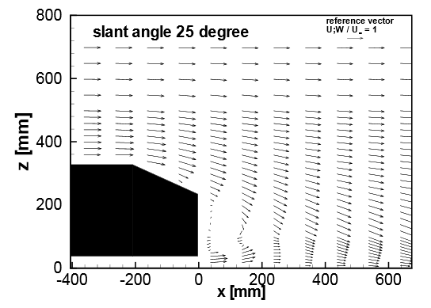
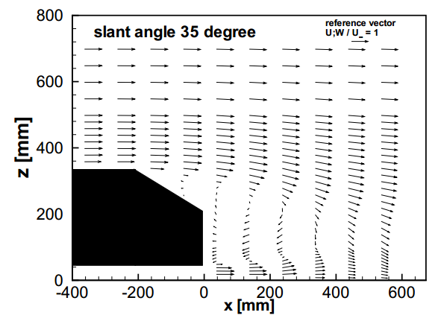
HPC: Turbulence Models Tested
Used Ahmed Body experimental results to validate turbulence models and numerical setups
RANS: k-ω SST, k-ε, RNG k-ε, Spalart-Allmaras
LES: One-Equation Eddy-Viscosity Model
Unable to generate stable solutions
Hybrid: Delayed-Detached Eddy-Simulation
Lienhart, H., Stoots, C. and Becker, S., 2000. Flow and Turbulence Structures in the Wake of a Simplified Car Model (Ahmed Model)

Slide 31
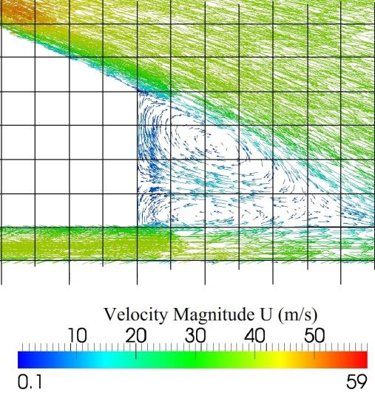
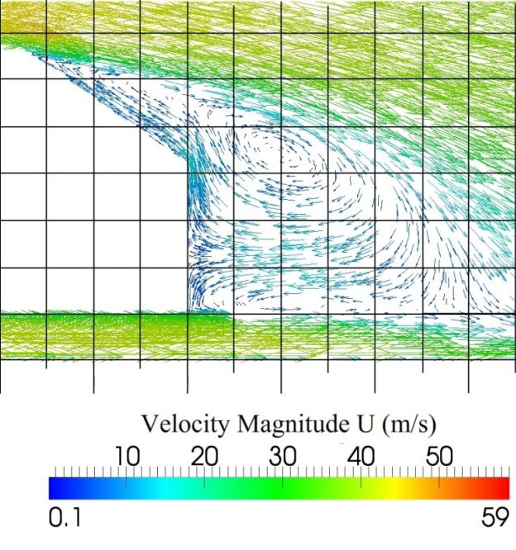
HPC: Vector Plots

Slide 32
HPC: Drag Coefficients
Spalart-Allmaras Model | Rear Slant Angle | Experimental Drag Coefficient | Computed Drag Coefficient | Error %
 | 25° | 0.299 | 0.292 | -2.3%
 | 35° | 0.279 | 0.294 | 5.4%
Spalart-Allmaras model (RANS) gave most accurate drag results and flow topology
Did not correctly predict a drop in drag above the critical rear-slant angle
DDES Model | Rear Slant Angle | Experimental Drag Coefficient | Computed Drag Coefficient | Error %
 | 25° | 0.299 | 0.341 | 14%
 | 35° | 0.279 | 0.294 | 5.4%
DDES results less accurate than Spalart-Allmaras
Correctly predicted a drop in drag above the critical rear-slant angle

Slide 33
HPC: Summary
Real-life flow profile shown to significantly affect the flow around the car model
Surrogate models may benefit the automotive industry by reducing the number of expensive CFD simulations needed
Spalart-Allmaras Turbulence Model generated the most accurate results
DDES correctly showed drop in drag seen beyond critical-slant angle

Slide 34
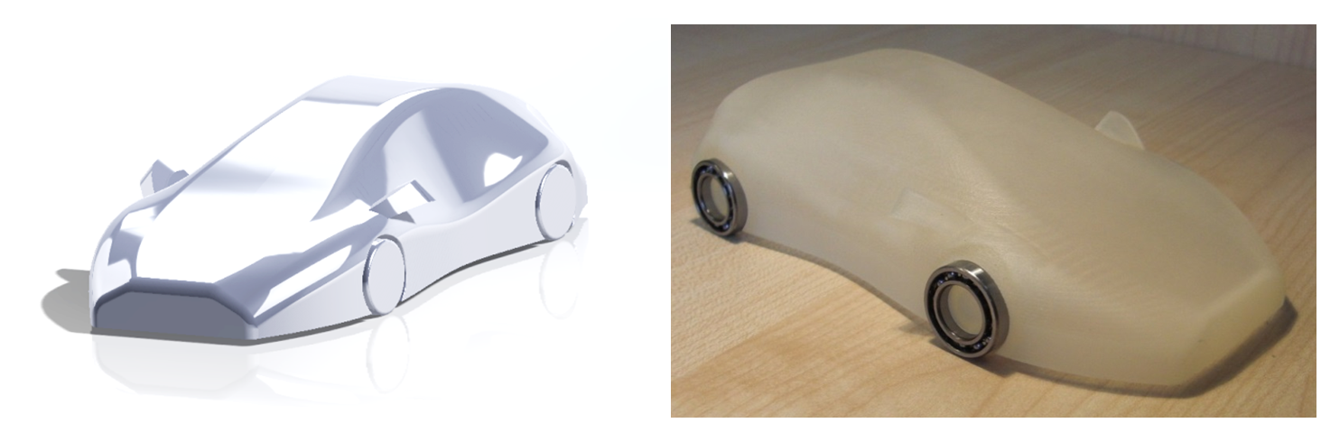
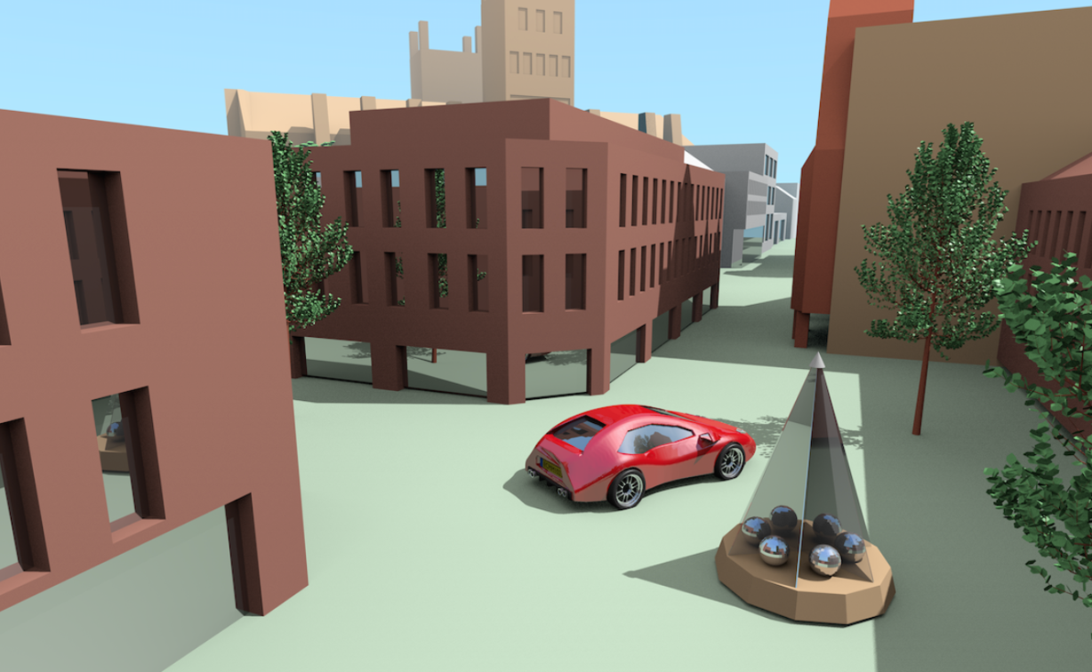
Final Results: Concept Car

Slide 35
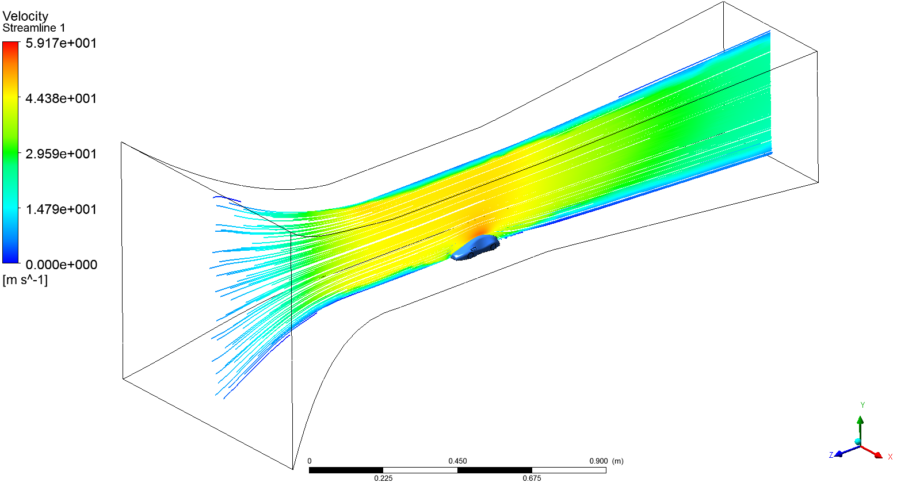
Final Results: Testing

Slide 36
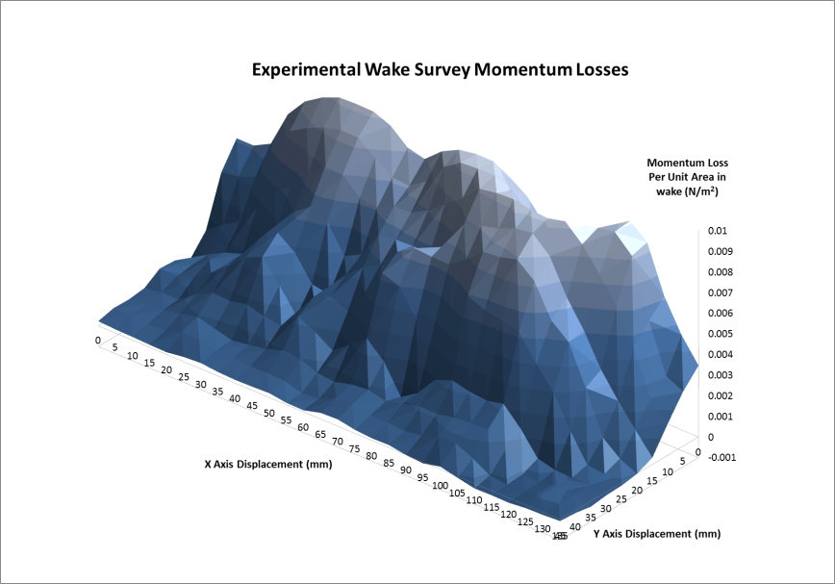
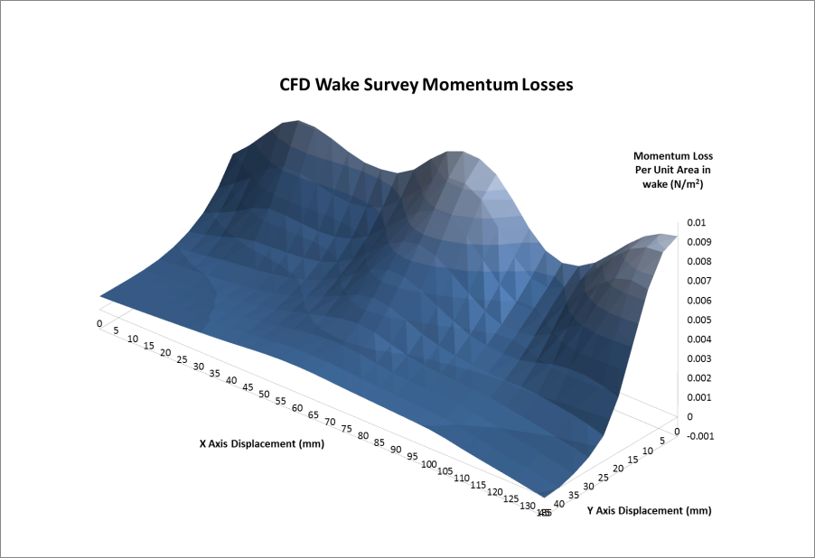
Final Results: Drag Coefficient Comparison
 | Computational | Experimental
Straight Test | 0.167 | 0.17 ± 0.015
Angled Test | 0.298 | 0.358 ± 0.077

Slide 37
Conclusions
Designed, manufactured and rendered a concept car
Successfully renovated existing wind tunnel to allow wake surveys and drag measurements
Created a Virtual Wind Tunnel (VWT) which accurately predicted the drag on an Ahmed body using RANS
Used the Ahmed body results to develop the VWT for the concept car
VWT drag results were compared with experimental results and were found to be in good agreement

Slide 38
Any Questions?

